Slide 1
lecture10_gam_in_practice
Grant Adams

Slide 2
Background II
In the simplest form a GAM is
$$y_{i}=f\left(x_{i}\right)+ϵ$$
$$f\left(x_{i}\right)=\sum_{i=1}^{q}{b_{i}}\left(x_{i}\right)*β$$
$f\left(x\right)$ = non-linear smooth function
$b_{i}$ = basis function that when combined becomes $f\left(x\right)$
$β$ = regression coefficient used to combine $b_{i}$

Slide 3
Polynomial basis (1)
3rd order polynomial
$b_{1}\left(x\right)=1$, $b_{2}\left(x\right)=x$, $b_{3}\left(x\right)=x^{2}$, $b_{4}\left(x\right)=x^{3}$
results in
$$f\left(x\right)=β_{1}+x*β_{2}+x^{2}*β_{3}+x^{3}*β_{4}$$
$$y_{i}=β_{1}+x_{i}*β_{2}+x_{i}^{2}*β_{3}+x_{i}^{3}*β_{4}+ϵ_{i}$$

Slide 4
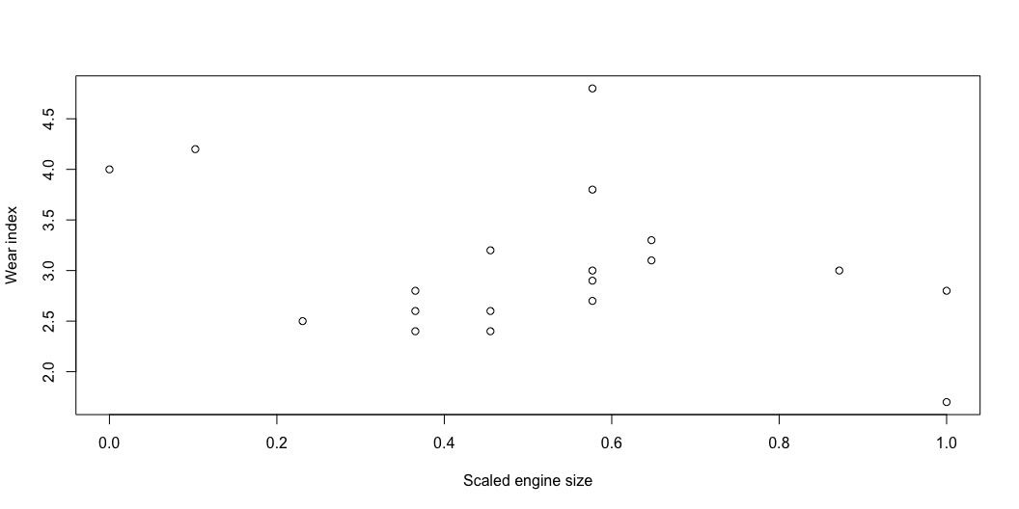
Generate data
Similar to a linear model??
# Generate data size<-c(1.42,1.58,1.78,1.99,1.99,1.99,2.13,2.13,2.13, 2.32,2.32,2.32,2.32,2.32,2.43,2.43,2.78,2.98,2.98) wear<-c(4.0,4.2,2.5,2.6,2.8,2.4,3.2,2.4,2.6,4.8,2.9, 3.8,3.0,2.7,3.1,3.3,3.0,2.8,1.7) x <- size - min(size) x <- x/max(x) # Plot plot(x, wear, xlab = "Scaled engine size", ylab = "Wear index")

Slide 5
Polynomial basis (2)
Similar to a linear model??
# Fit model mod <- lm(wear ~ x + I(x^2) + I(x^3))

Slide 6
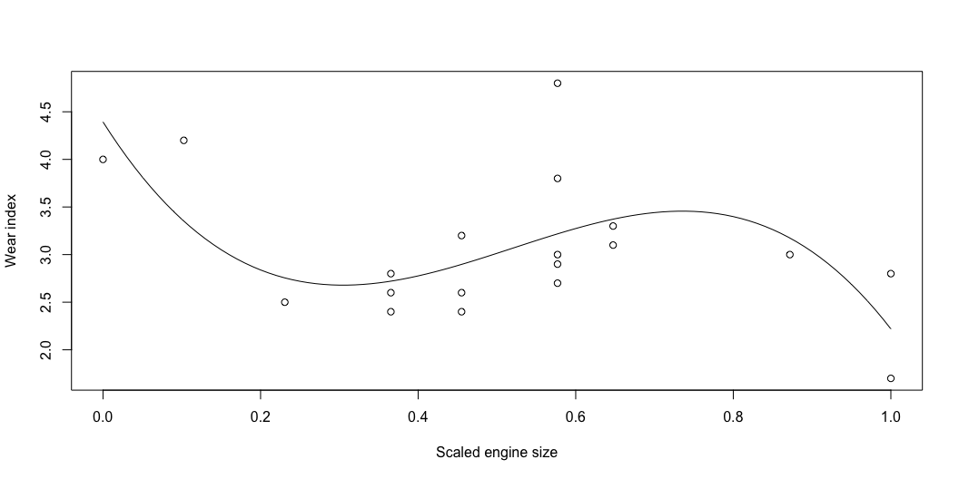
Plot polynomial basis
# Get beta b1 = mod$coefficients[1]; b2 = mod$coefficients[2]; b3 = mod$coefficients[3]; b4 = mod$coefficients[4]; # Plot plot(x, wear, xlab = "Scaled engine size", ylab = "Wear index") curve(b1 + x*b2 + x^2*b3 + x^3*b4, from = 0, to = 1, add = TRUE)

Slide 7
Cubic spline basis
$b_{1}\left(x\right)=1$, $b_{2}\left(x\right)=x$
$b_{i+2}=R\left(x,x_{q}^{*}\right)$
$$R\left(x,x_{q}^{*}\right)=\left[{\left(x_{q}^{*}−1/2\right)}^{2}−1/12\right]\left[{\left(x−1/2\right)}^{2}−1/12\right]/4−\left[{\left(\left|x−x_{q}^{*}\right|−1/2\right)}^{4}−1/2{\left(\left|x−x_{q}^{*}\right|−1/2\right)}^{2}+7/240\right]/24$$
where $x_{q}^{*}$ is the location of $k$ knots along the range of $x$
By default mgcv will select the locations based on quartiles or even location of $x$

Slide 8
Cubic spline basis in R by hand (1)
rk<-function(x,z){ # R(x,x*) for cubic spline on [0,1] ((z-0.5)^2-1/12)*((x-0.5)^2-1/12)/4- ((abs(x-z)-0.5)^4-(abs(x-z)-0.5)^2/2+7/240)/24 } spl.X <-function(x, xk){ # setup model matrix forcubic penalized regression spline q <- length(xk)+2 # number of parameters n <- length(x) # number of data X <- matrix(1, n, q) # initialized model matrix X[, 2] <-x # set second column to x X[,3:q]<-outer(x,xk,FUN=rk) # and remaining to R(x,xk) X }

Slide 9
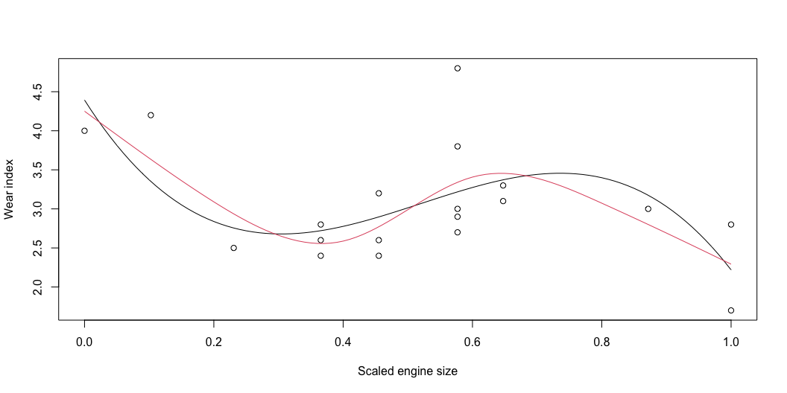
Cubic spline basis in R by hand (2)
xk <- 1:4/5 # choose location of 4 knots Xmat <- spl.X(x, xk) # generate model matrix mod.1 <- lm(wear ~ Xmat - 1) # fit model xp <- 0:100 / 100 # x values for prediction Xp <- spl.X(xp, xk) # prediction matrix # Plot plot(x, wear, xlab = "Scaled engine size", ylab = "Wear index") curve(b1 + x*b2 + x^2*b3 + x^3*b4, from = 0, to = 1, add = TRUE) lines(xp, Xp %*% coef(mod.1), col = 2) # plot fitted spline

Slide 10
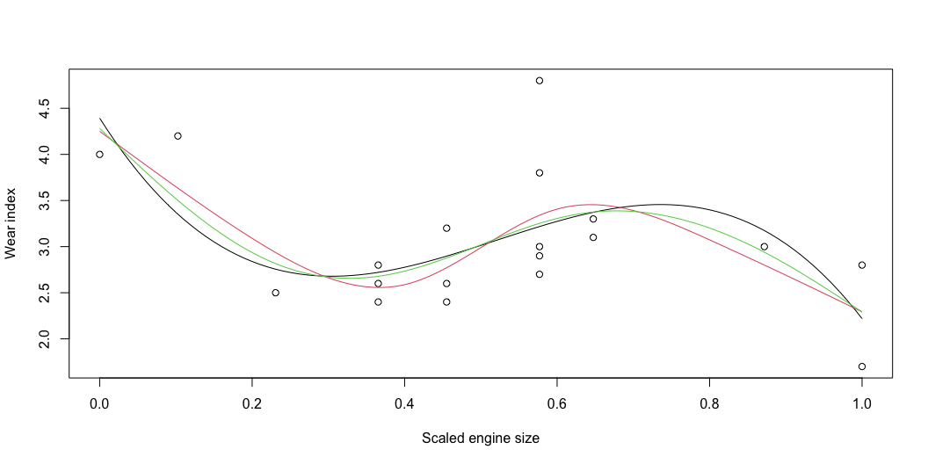
Cubic spline basis in R mgcv
# Fit GAM library(mgcv) mod.2 <- gam(wear ~ s(x, k = 4, fx = F)) # fit model with 4 knots predy <- predict(mod.2, newdata = data.frame(x = xp), type = "response") # Plot plot(x, wear, xlab = "Scaled engine size", ylab = "Wear index") curve(b1 + x*b2 + x^2*b3 + x^3*b4, from = 0, to = 1, add = TRUE) lines(xp, Xp %*% coef(mod.1), col = 2) # plot fitted spline lines(xp, predy, col = 3)

Slide 11
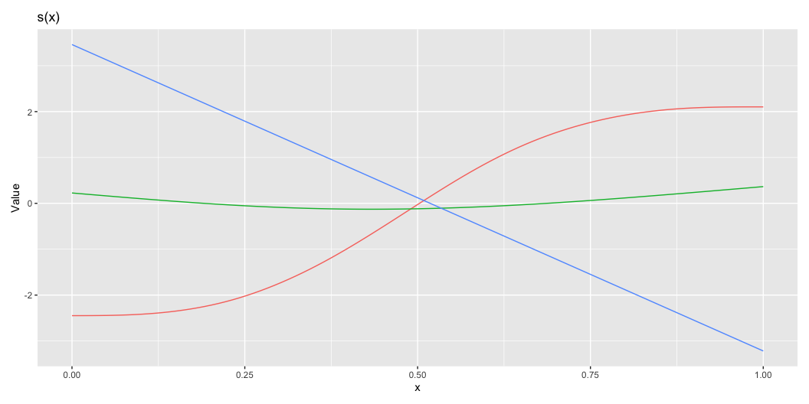
Basis functions
library(gratia) library(dplyr) basis(mod.2) %>% draw()

Slide 12
Basis functions
Many different smooth terms!
bs = "cr" for cubic splines
bs = "cs" for cubic splines with shrinkage (eliminates uninformative covariates)
bs = cc for cyclic regression spines where first and last value of $x$ match (season, day of the year, time of data)
bs = re simple IID normal random effects

Slide 13
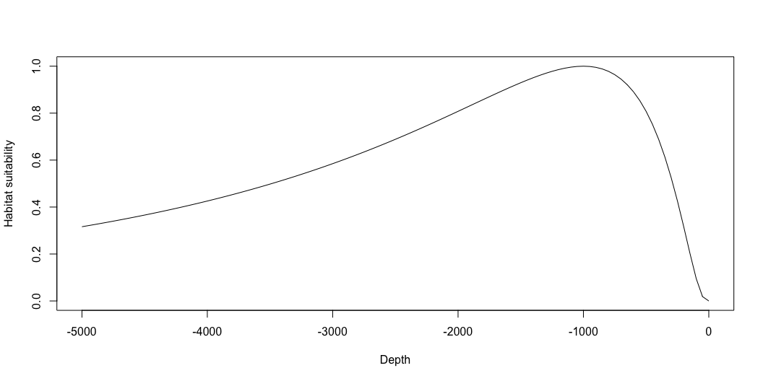
1D models
GAMs are great at approximating non-linear functions
Remember our simulated survey data?

Slide 14
1D models
GAMs can be used to fit to the survey data and approximate the curve:
source("Simulate_Spatial_Data_No_Plots.R") library(mgcv) gm.1 <- gam(CPUE ~ s(Depth, k = 10) + as.factor(Year), data = haul_data, family = poisson, select = TRUE)

Slide 15
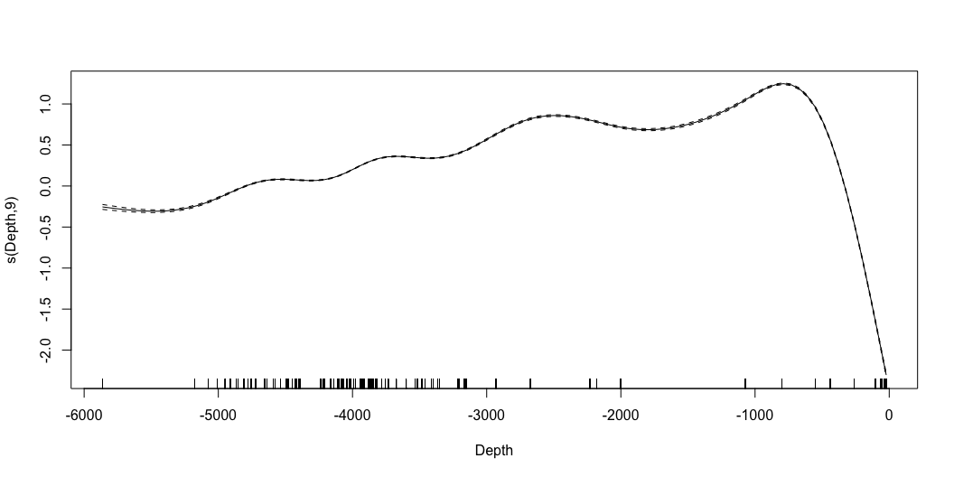
plot(gm.1)

Slide 16
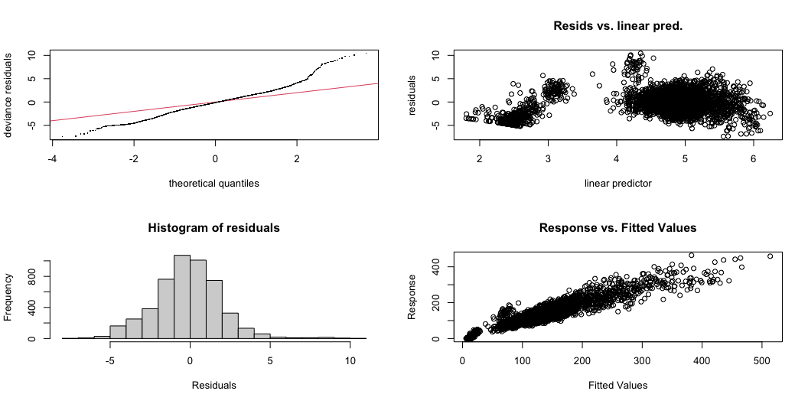
Diagnostics
gam.check(gm.1)

Slide 17
Method: UBRE Optimizer: outer newton full convergence after 14 iterations. Gradient range [1.053228e-07,4.660583e-06] (score 3.359395 & scale 1). Hessian positive definite, eigenvalue range [1.086195e-07,9.449816e-06]. Model rank = 59 / 59 Basis dimension (k) checking results. Low p-value (k-index<1) may indicate that k is too low, especially if edf is close to k'. k' edf k-index p-value s(Depth) 9 9 0.48 <2e-16 *** --- Signif. codes: 0 '***' 0.001 '**' 0.01 '*' 0.05 '.' 0.1 ' ' 1

Slide 18
Diagnostics
plot(gm.1)

Slide 19
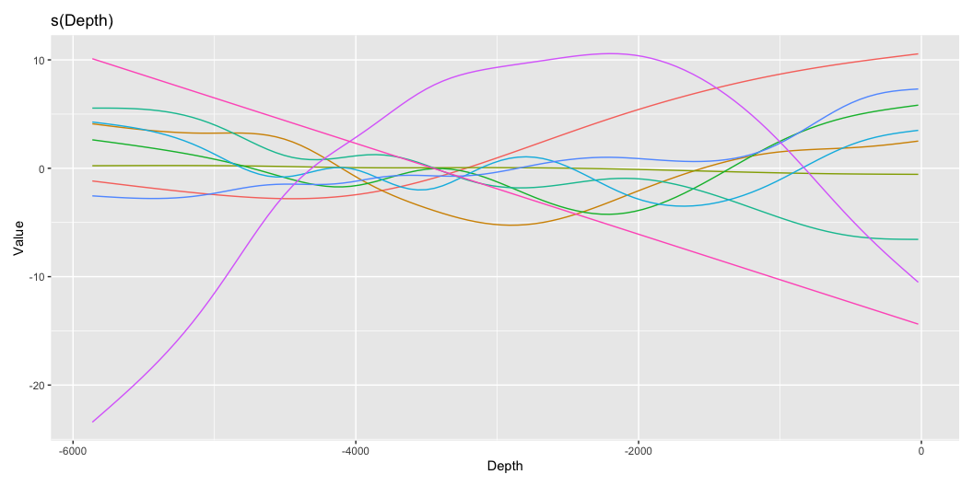
Plot partial smooths
library(gratia) basis_weights <- smooth_coefs(gm.1, select = "s(Depth)") basis(gm.1) %>% draw()

Slide 20
Spatial models
GAMs are great for spatial modelling
Using interactions

Slide 21
Simulated survey data
gm.2 <- bam(CPUE ~ ti(X, Y, k = c(15, 15)), data = haul_data_random, family = poisson, select = TRUE)

Slide 22
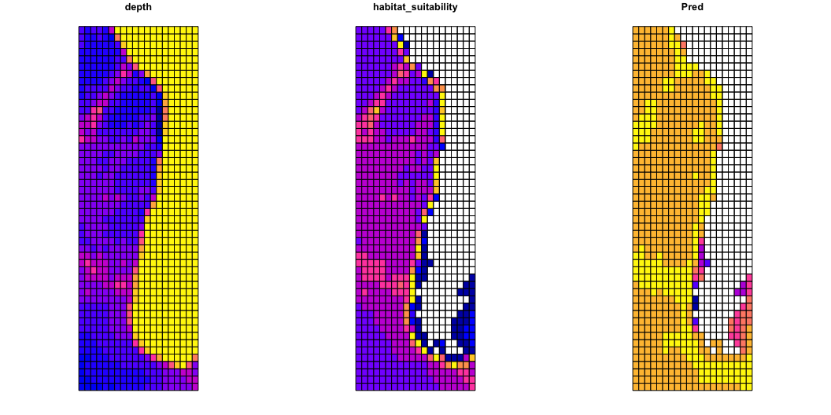
# Predict distribution pred <- data.frame(X = polygony$X, Y = polygony$Y) pred$pred <- predict(gm.2, pred) # Plot polygony <- polygony %>% dplyr::mutate(Pred = pred$pred) plot(polygony[c("depth", "habitat_suitability", "Pred")])

Slide 23
Mackerel egg survey
Borchers et al. (1997) sampled eggs of mackerel to understand their spatial distribution and relation to environmental predictors.
library(gamair) data("mack") mack$log.net.area <- log(mack$net.area) gm <- gam(egg.count ~ s(lon, lat) + offset(log.net.area), data = mack, family = nb, control = gam.control(maxit=100))

Slide 24
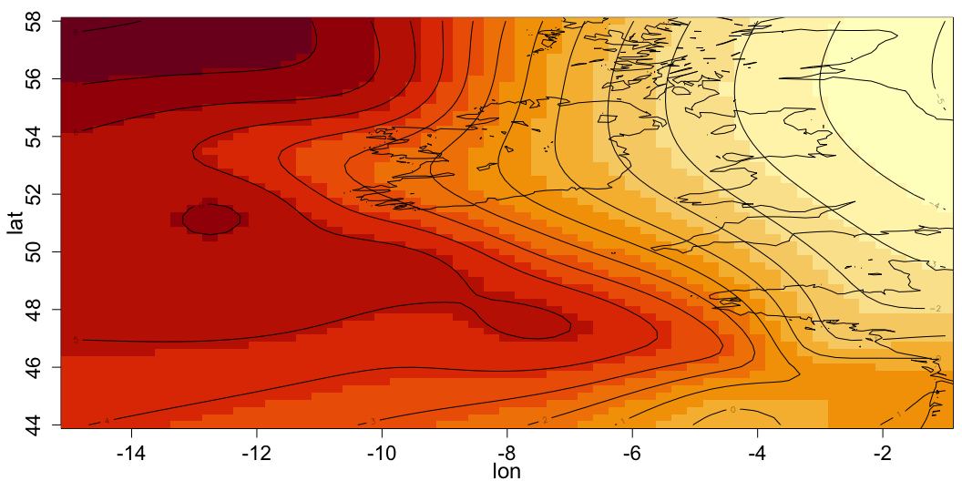
# Coastline data("coast") # Predict distribution lon = seq(-15, -1, by = 0.25) # X lat = seq(44, 58, by = 0.25) # Y pred <- expand.grid(lon = lon, lat = lat) pred$log.net.area <- 0 pred$pred <- predict(gm, pred) # Plot par(mar = c(3,3.5,1,0.5), mgp = c(2,1,0)) image(lon, lat, matrix(pred$pred, 57, 57), cex.lab=1.5, cex.axis=1.4) contour(lon, lat, matrix(pred$pred, 57, 57), add = TRUE) lines(coast$lon, coast$lat, col=1)

Slide 25
Problems?

Slide 26
Problems?
Can use soap film smoothers to account for coastlines and islands
bs = "so"

Slide 27
Random effects approach
Integrate over space for indices
https://pbs-assess.github.io/sdmTMB/

